Slide 1
ITEC 101 Fundamentals of Information Technology
DANIEL OBUOBI, DCSIT, CU
DATA COMMUNICATION

Slide 2
INTRODUCTION
Data communication is the sending of data between geographically separated computers.
Explosion due to advances in computer and communications technology
Result is vast communication networks worldwide.
Data are sent over a telephone line, bounced off satellites, and carried through the air by microwaves.
Defined as the process of transferring data or information over communication using computers.
Data could be voice, text or graphics etc.

Slide 3
APPLICATION OF DATA COMMUNICATION
Information services
Offer interactive services to users
Services are easy to use & accessed with PC
E.g. Info. retrieval, email, telemonitoring, shopping, banking, travel …
The Internet
a communication system for exchanging and distributing information all over the world e.g. WWW
E-mail (Electronic mail)
Much faster than conventional postal services.
Messages can reach any destinations in sec/mins
Electronic funds Transfer
electronic transfer movement of money into, out of, and between bank’s accounts.
Example are ATM and credit card system
Computer conferencing
use computers network to create a meeting situation where information or messages can be exchanged directly and immediately,
Telecommuting
working at home using computer, data com & network make it feasible

Slide 4
COMPONENTS OF DATA COMMUNICATION
A data communication system is made up of three main components:
Communication hardware
Communication software
Communication channel
Communications hardware
The physical components or equipments used to construct the communication system. This includes items such as
terminals
modems
computers and
Interface Units.

Slide 5
TERMINAL, MODEM, COMPUTERS
Terminal
All types of terminals (dumb etc) are used
They are located at the end of comm. lines.
All kind of I/O devices are used including scanners, touch screens, printers and plotters.
Modem
enables a computer or terminal to transmit and receive data to over a telephone line
Computers
Any computer ranging from palm computers to supercomputers can be used.
The computer through its process ability and speed make data communication possible.

Slide 6
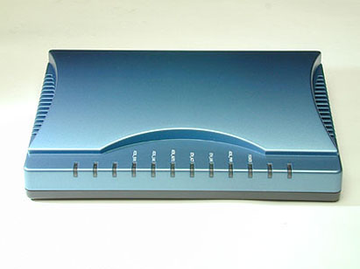
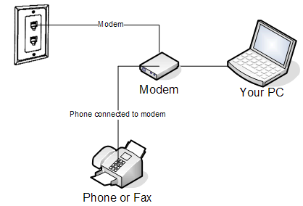
Modem

Slide 7
INTERFACE UNITS
These are hardware components that enable data to be transmitted over the communication lines.
They coordinate various aspects of data transmission and reception.
They greatly increase the overall efficiency of the system in which they are used.
Such devices include multiplexers, Concentrators, front-end processor and message switchers.

Slide 8
MULTIPLEXER
Enables a number of data channels to be accommodated on a single communication line for transmission to and from the computer.
It combines a number of signals from several terminals into a single transmission to be carried by one communication channel.
It receives data from a number of terminals, batches the terminal messages and transmits them at high speeds to the computer.
➔ A number of terminals may share a common multiplexer and all transmissions are communicated to the computer by a single communication line.
Arrangement economizes the number of lines required and reduces the cost of leasing telephone line.
A multiplexer treats a high speed communication line as if it were multiple lower speed lines, resulting in a much more economical use of these lines.

Slide 9
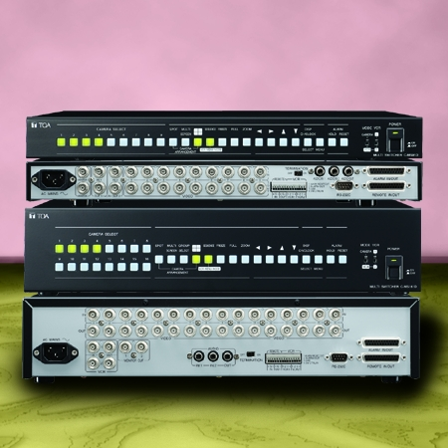
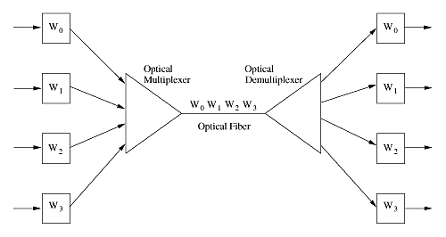
MULTIPLEXER

Slide 10
CONCENTRATOR
It is a minicomputer or microcomputer that combines the data from number of terminals onto a single high-speed line to a central computer.
Similar to the multiplexer, but more sophisticated, often having an internal memory.
Differs from a Multiplexer in that it waits until a group of characters is collected from each terminal instead of interleaving the data streams character by character.
Have in-built processing capabilities and may be programmable whereas multiplexes are basically unintelligent unit.
Concentrators ensure efficient use of expensive communication channels.

Slide 11
MESSAGE SWITCHERS
It is a device that
Receives all transmissions from all terminals,
analyzes them to determine their destinations and proper routing,
and then forwards them to the appropriate locations.
Capable of storing transmission if appropriate communication lines aren’t immediately available.
They increase the efficiency of a data comm. system by relieving the main computers of routing responsibilities.
That is the handle the routing of data transmission between terminals and the computer.

Slide 12
FRONT END PROCESSOR
It is a computer that is usually located at the same site as the central computer in a data communication system.
Its function is to relieve the central computer of routine transmission-oriented tasks.
This leaves the central computer free for processing applications programmes, thus increasing the amount of processing that can be accomplished in a given time.
FEP can be programmed to do
message switching,
error checking,
data translating and transmission
co-ordination and control.
They keep log file,
compile statistics concerning data communication activities and
maintain security by limiting access to authorized users.

Slide 13
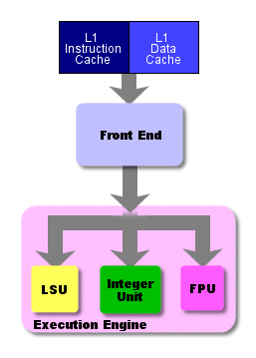
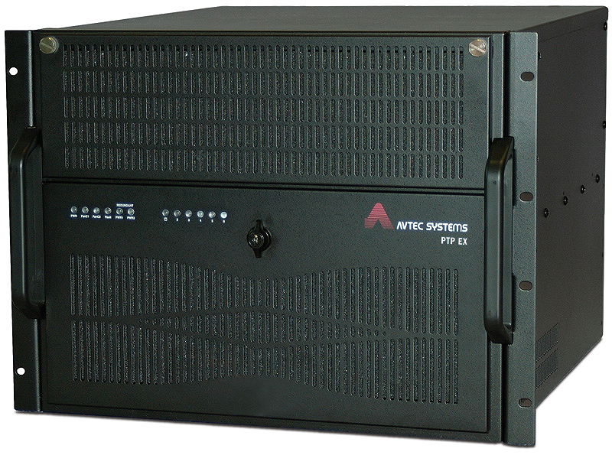
FRONT END PROCESSOR

Slide 14
COMMUNICATION SOFTWARE
A program that controls the manner in which data communication is done.
It establishes, coordinates, monitors and controls the flow of data through the system.
In other words,
it controls how data is transferred,
when it should be transferred and
in what manner the data should be transferred ( i.e. whether in batches or as single entities).
It is the engine that drives data communication.

Slide 15
TASK OF COMM. SOFTWARE
The tasks for data communication are:
Opening and closing of communication lines
Establish correct connection for transmission & break it after transmission has been sent.
It may also maintain a bank of telephone lines.
Finding and correcting transmission errors
determine if errors have occurred and cause the data to be re-transmitted.
Coordinating multiple use of comm. Lines (to maintain smooth flow)
Poling technique: each terminal in turn is “asked” if it has data to send.
Contention: each terminal is “asked” to listen if any terminal is transmitting and if so wait
Routing data transmission
handle routing may also perform queuing or ordering transmission into some sequence of priority
Keeping statistics
compile useful facts about system performance, such as the number of errors that have occurred and how many transmission have been sent.

Slide 16
COMMUNICATION CHANNEL
Communication channel (lines or media) are pathways or route over which data is sent.
They link the various computers and terminals in the communication system to one another.
3 main characteristics are important. These are:
Physical Structure
Transmission direction
Line configuration

Slide 17
THE MAIN CHARACTERISTICS
Physical structure (type of line used)
Examples are Wire cables (coaxial cable, twisted pair cable), Microwave, Fiber Optic cable, Satellites
Transmission direction (how data flows)
example simplex, half-duplex and full-duplex.
Line Configuration ( how lines are interconnected)
examples– point to point and multi-drop.

Slide 18
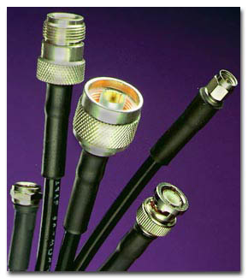
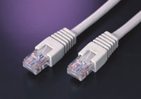
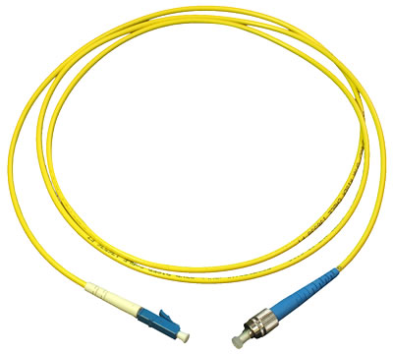
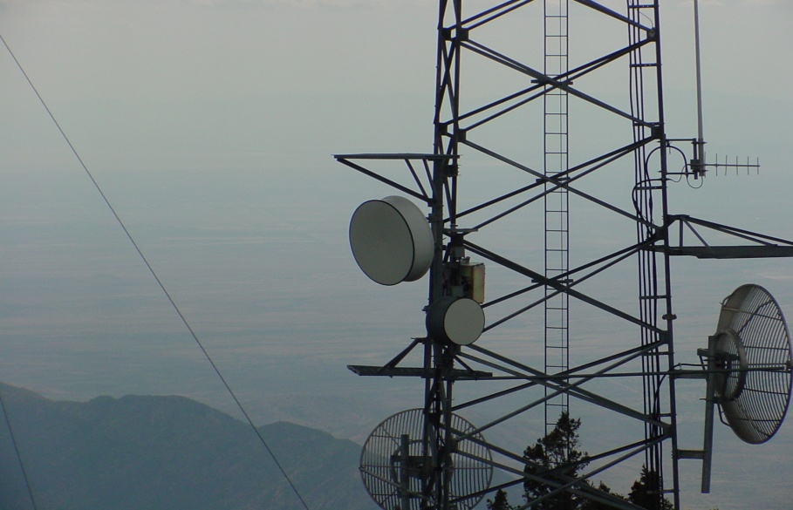
COMMUNICATION MEDIA

Slide 19
SIMPLEX, HALF DUPLEX, FULL DUPLEX
A simplex channel
transmits in one direction only. It can only send or receive but not both.
An example is the TV set – can only receive broadcast signals but cannot send out signal.
A half-duplex channel
allows transmission in either direction but in alternative fashion.
That is it can send and receive data but not at the same time. Eg Telephone.
Full-duplex channel
allows transmission in both directions simultaneously.
Signals can travel in both directions at the same time.

Slide 20

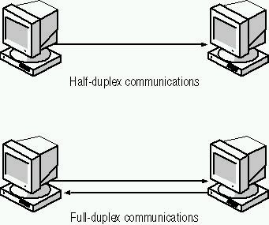
Simple, half duplex, full duplex

Slide 21
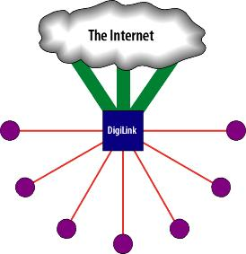
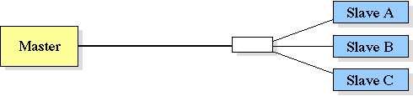
POINT-POINT, MULTIDROP
Point-to-point
connects each terminal to the computer by a separate line
multi-drop
connects several terminals to the computer using a single channel.

Slide 22
NETWORKS
Most networks are composed of multiple terminals and personal computers, and possibly multiple large host computers to enable the network to function most efficiently an productively.
Many combinations can be used, but network design is usually categorized as one of two basic types;
Star Network and
Ring Network
Others are:
The Tree
The Bus
The Hub

Slide 23
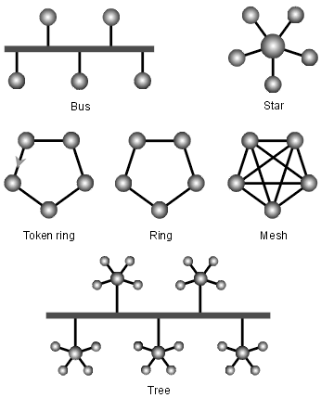
Network topologies

Slide 24
LOCAL AREA NETWORK
Consists of two or more PCs physically connected.
Typically coaxial or fiber optic cables + specialized interface units provide very fast data transmission.
Once established a LAN
enables all of its uses to exchange programs, data and essential information at high speeds.
allow expensive equipment such as large-capacity hard disk drives, printers to be shared efficiently by users within the same organization
enable PC users to take advantage of local mainframe resources.

Slide 25
OTHER TERMS
WAN - Wide Area Network. (long haul network)
connects systems that are physically far apart.
Slower than LANs and point-to-point.
Often based on telephone lines and/or satellite
MAN - Metropolitan Area Network.
They are smaller than a WAN and larger than a LAN.
Examples include our campus-wide network.
Inter-network - connection of two or more distinct (possible dissimilar) networks.
Usually requires some kind of network device to facilitate the connection
Protocol –
a specification for format of exchange of info. between two end-systems (anything that communicate on a network)

Slide 26
OSI REFERENCE MODEL
a layered model used to describe network protocols and services. The OSI model includes 7 layers:
7. Application - highest level layer
6. Presentation
5. Session
4. Transport
3. Network
2. Data Link
1. Physical - lowest level layer

Slide 27
THE LAYERS
Physical Layer - transmission of raw bits over a communication channel.
Data Link Layer - transmission of chunks of data (frames) between two end-systems on the same network.
The Data Link layer uses the physical layer to physically send bits of data.
Network Layer - transmission of chunks of data (packets) between two end-systems on possibly different networks.
The Network layer uses the Data Link layer to send data between two end-systems on the same network,
Transport Layer - transmission of chunks of data between processes on two end systems that are on possibly different networks.
The Transport layer uses the Network layer to send data, in addition the destination endpoint must be able to identify and send data to the correct process.
Process - an instance of a program that is currently running.
Program - a file containing instructions that can be executed by a computer.
Session Layer - manages communication session between two processes (session creation and termination).
Presentation Layer - provides data translation/conversion so that many kinds of end-systems can exchange information (end-systems do not all need to use the same internal representation for information). Can also involve encryption/decryption or compression/decompression.
Application Layer - communication between two end-systems that deals with the specific nature of a network application. (In other words - anything not provided by any of the lower level layers).

Slide 28
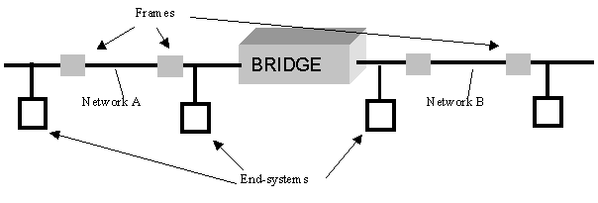
BRIDGE
A network device that connects two or more networks at the Data Link layer.
Forwards frames from one network to another.

Slide 29
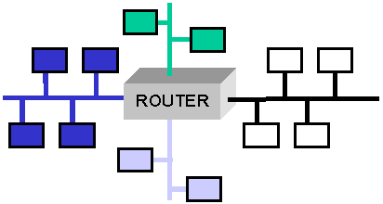
ROUTER
a network device that connects two or more networks at the Network layer.
A router forwards packets between networks making decisions about what network should receive each packet.

Slide 30
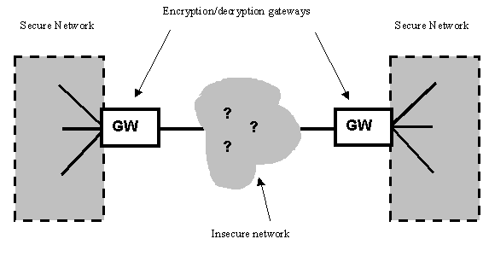
GATEWAY
Does some data conversion at layers higher than the Network layer.
Used to provide connection between different (applications or network layers).
provides for the secure connection of two networks using an insecure network:

Slide 31
CLIENT / SERVER
Client/Server
A model for sharing of resources and information between processes (typically processes running on different computers connected by a network).
Server
A process that provides some service (resources or information) to another process (a client).
A server accepts requests and returns responses. Always ready (running). E.g. web servers, file servers, print servers and mail servers.
Client
A process that makes requests from a server, typically in response to user action.
A client process is the process that makes the initial request, although this process may then provide some server to the peer process. A process can be both a client and server, for example, a proxy web server.

Slide 32
NOW

